Slide 1

604 Data Management HOUSING MARKET DATA ANALYSIS

Slide 2
Members of Team 3:
Lavanya Telapudi
Pavan Kalyan Reddy Chinthakuntla

Slide 3
Introduction
The aim of this project is to give information about the Housing details to the customers and how house prices have risen at record levels in recent months, hitting the peak increase of 19.3 percent in July 2021 in the wake of the short but steep COVID-19 recession.
Ability to set up property information such as, this data from Redfin summarize the monthly housing market for every State, Metro, and Zip code in the US from 2012 to 2021.
It includes property type, like whether it is a Residential or Townhouse or Single-family home or a Cooperative.
Home sales, Average sale to list, Inventory, Median active list price, Median sale price, Pending home sales, Total homes sold with price drops are also included in the property information
The key focus is given to the new residential market statistics for new construction homes. Included building permit data provided by the Census—allowing users to analyze average construction costs and compare the number of units built per capita across regions.

Slide 4
Overview
This residential real estate data set was created by Redfin, an online real estate brokerage. Published on January 9th, 2022, this data summarize the monthly housing market for every State, Metro, and Zip code in the US from 2012 to 2021. Redfin aggregated this data across multiple listing services and has been gracious enough to include property type in their reporting. Please properly cite and link to RedFin if you end up using this data for your research or project.
Property Type
Property type defined by RedFin
All Residential: All properties defined as single-family, condominium, co-operative, townhouses, and multi-family (2-4 units) homes with a county record.
Single Family Home (SFH): are homes built on a single lot, with no shared walls. Sometimes there’s a garage, attached or detached.
Condominium (Condo): Usually a single unit within a larger building or community. Generally, come with homeowners’ associations (HOAs), which require the residents to pay monthly or yearly dues.
Cooperatives (Co-op): Usually a single unit within a larger building or community, but with a different way of holding a title to a shared building. You join a community and everyone in the community owns the building together.
Townhouse: a hybrid between a condo and a single-family home. They are often multiple floors, with one or two shared walls, and some have a small yard space or rooftop deck. They’re generally larger than a condo, but smaller than a single-family home.
Multifamily (2-4 units): They are essentially a home that has been turned into two or more units but the units cannot be purchased individually. There is one owner for the whole building.
Land: Just land, no home of any type for sale.

Slide 5
Average sale to list: The mean ratio of each home's sale price divided by their list price covering all homes with a sale date during a given time period. Excludes properties with a sale price of 50%.
Home sales: Total number of homes with a sale date during a given time period.
Inventory: Total number of active listings on the last day of a given time period.
Median active list ppsf: The median list price per square foot of all active listings.
Median active list price: The median list price of all active listings.
Median days on market: The number of days between the date the home was listed for sale and when the home went off-market/pending sale covering all homes with an off-market date during a given time period where 50% of the off-market homes sat longer on the market and 50% went off the market faster. Excludes homes that sat on the market for more than 1 year.
Median list price: The most recent listing price covering all homes with a listing date during a given time period where 50% of the active listings were above this price and 50% were below this price.
Median listing with price drops: The median of how many listings were active on each day and whose current list price is less than the original list price within a given time period.
Median sale price per square foot: The final home sale price divided by the total square feet of the property (not the lot) covering all homes with a sale date during a given time period where 50% of the sales were above this price per sqft and 50% were below this price per sqft.
Months of supply: When data are monthly, it is inventory divided by home sales. This tells you how long it would take supply to be bought up if no new homes came on the market.
New listings: Total number of homes with a listing added date during a given time period.
Sold above list: The percent of homes sales with a sale price greater than their latest list price covering all homes with a sale date during a given time period. Excludes properties with a sale price 50% above the listing price or with a sale price 50% below the list price.
Total active listings: The total number of listings that were active at any point during a given time period.
Total homes sold with price drops: The total number of homes with a sale date during a given time period and where the sale price is less than the latest listing price.

Slide 6
Purpose of Data Analysis:
which type of Property are customers interested to buy over the years?
Total number of homes that were sold in each state or metro station during a given time period.
How real-estate got affected due to Covid-19
Despite the large drops in home sales due to the pandemic, real estate activity began to improve in the late spring, approaching pre-pandemic levels by the summer. Potential buyers started to increase their housing search and purchase activity by the end of May.
Americans, many now used to work remotely, began buying farther away from some cities and traditional job centers and that is why sales increased relatively from 2019 to 2021

Slide 7
This dataset from Redfin tells us about the inventory where it is total number of active listings on the last day of a given time period.
Median days on market: The number of days between the date the home was listed for sale and when the home went off-market/pending sale covering all homes.
It also gives us the info about the Median list price per square foot and Median sale price per square foot.
Total homes sold with price drops :The total number of homes with a sale date during a given time period and where the sale price is less than the latest listing price.

Slide 8
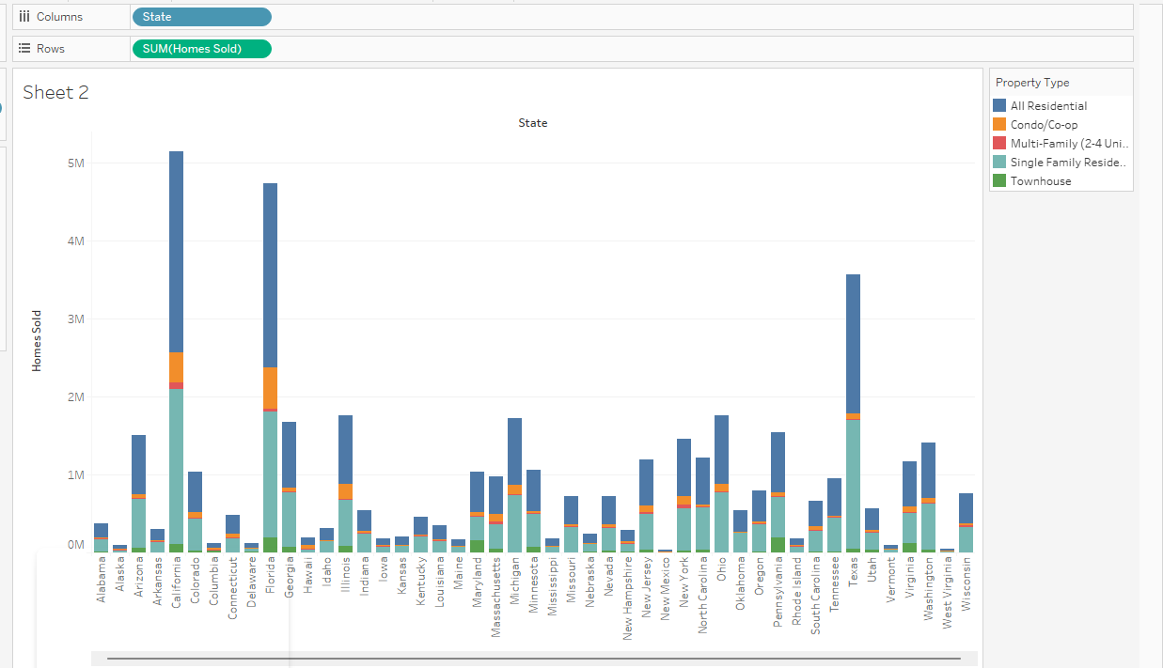
Visualizations From Tableau
1

Slide 9
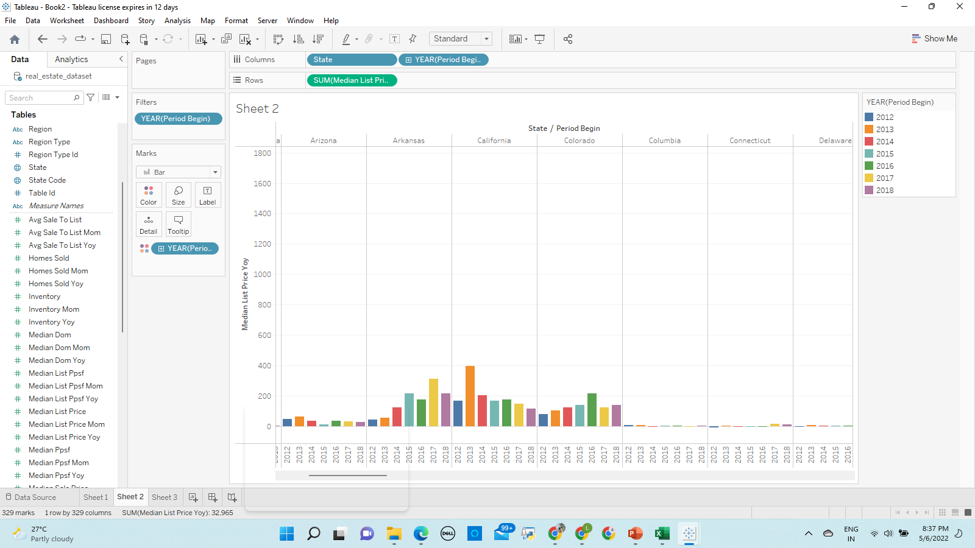
2

Slide 10
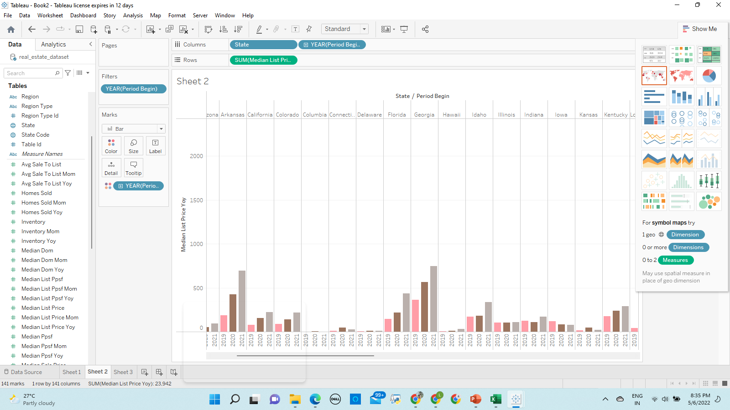
Homes are 34% more expensive. Buyers are twice as likely to pay above list price as they grapple with fierce competition.

Slide 11
Inventory:
a raw count of the number of properties being actively marketed
If inventory is decreasing, there is more pressure for home prices to increase.
New listings, despite improving from their April lows, were only slightly higher than one year ago through August. As a result, inventory continued to decline: In August 2020, there were less than two-thirds the number of homes on the market as there were in August 2019. While health-related concerns may continue to keep sellers from the market, surveys indicate that the overall economic uncertainty and the inability to purchase another home are also keeping homeowners in place.

Slide 12
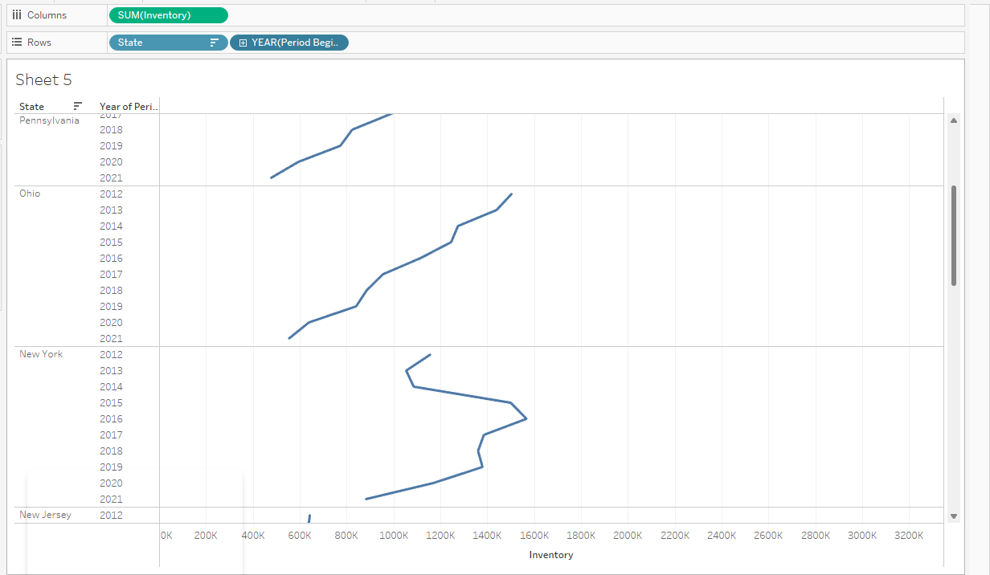
3

Slide 13
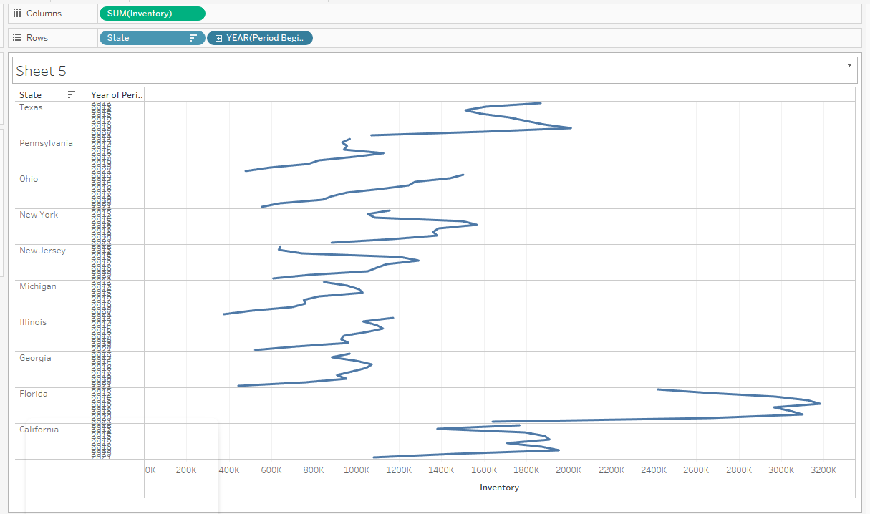

Slide 14
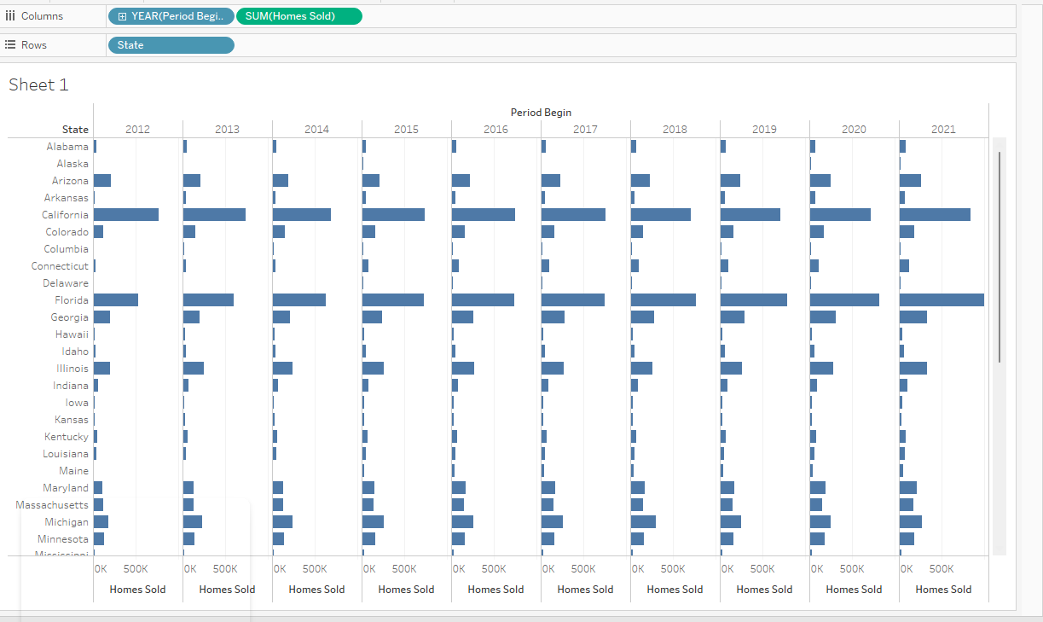
4

Slide 15
Target Users
This system will be used by multiple people with different roles and responsibilities:
Property Manager
Listing Agent
Possible Tenant
Possible Buyer
Tenant
Researcher etc

Slide 16
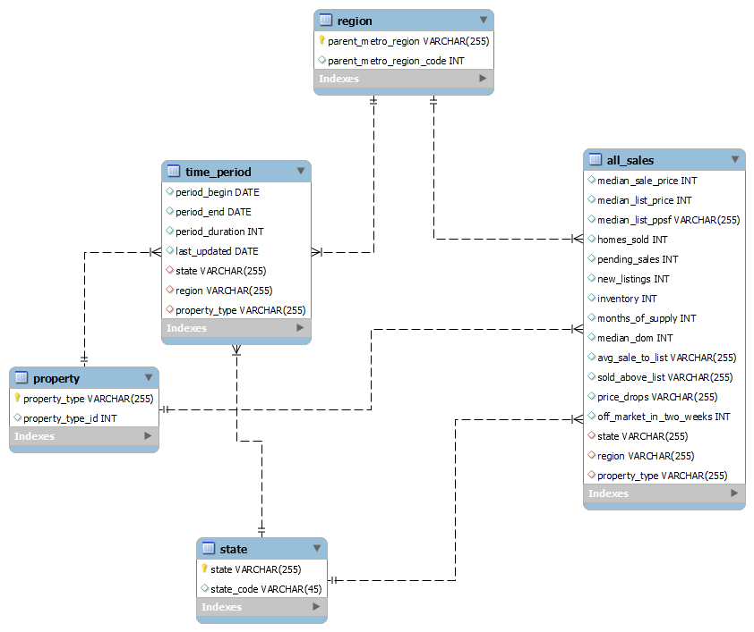
ER Diagram

Slide 17
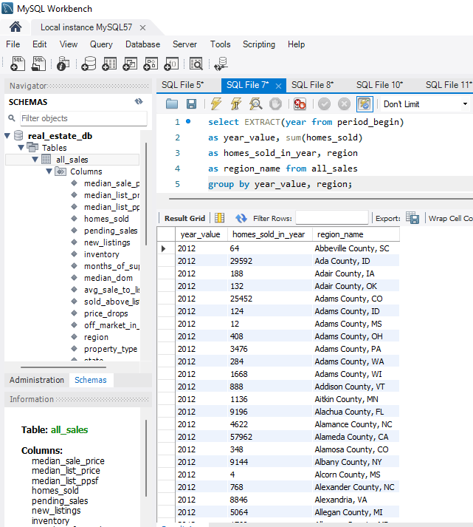
Case study 1

Slide 18
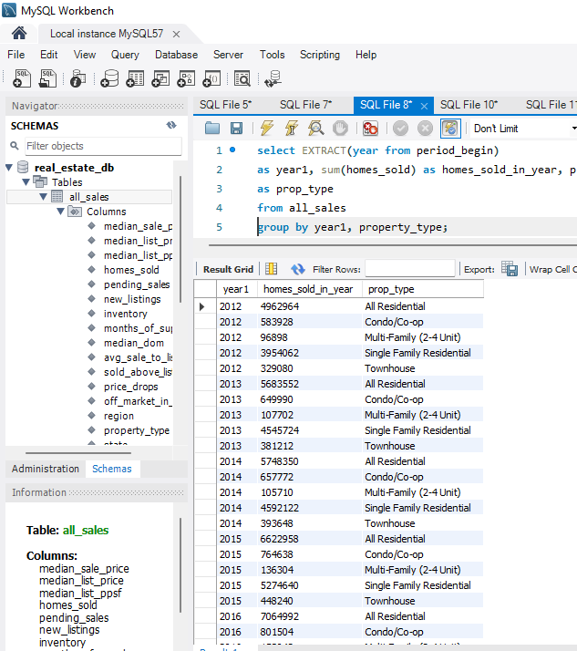
Case study 2

Slide 19
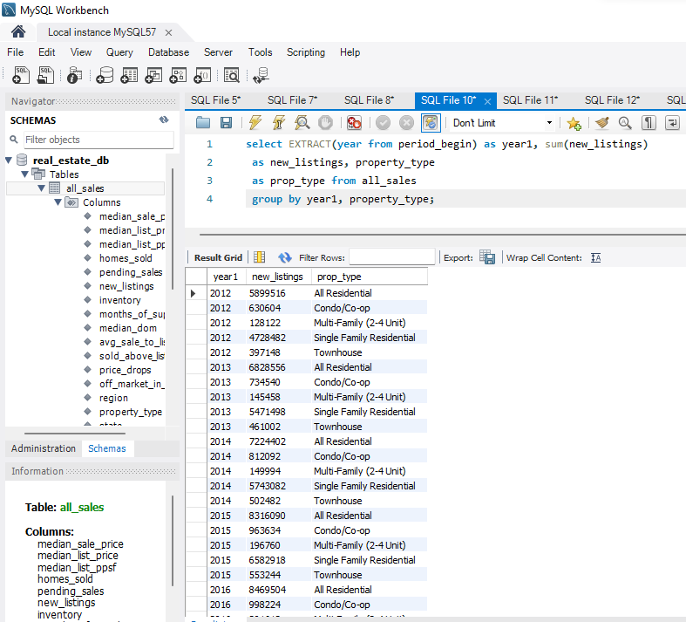
Case study 3

Slide 20
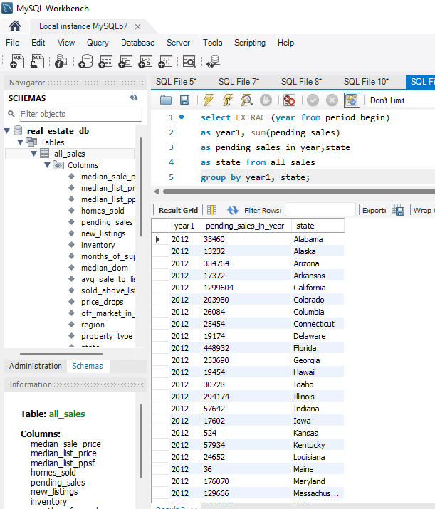
Case study 5

Slide 21
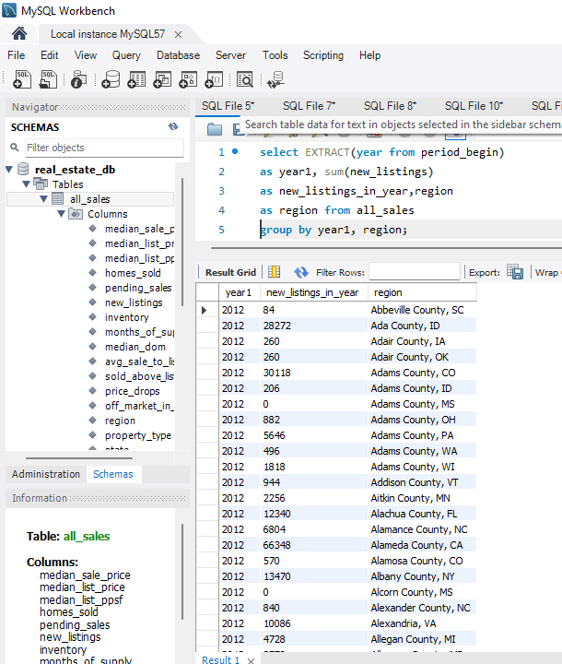
Case study 6

Slide 22
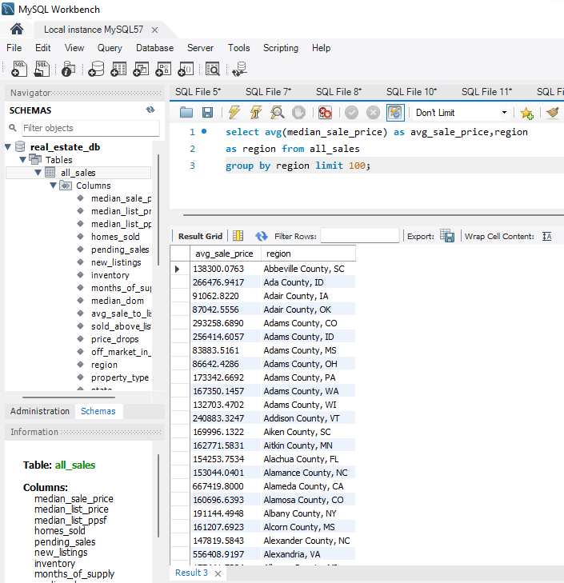
Case study 7

Slide 23
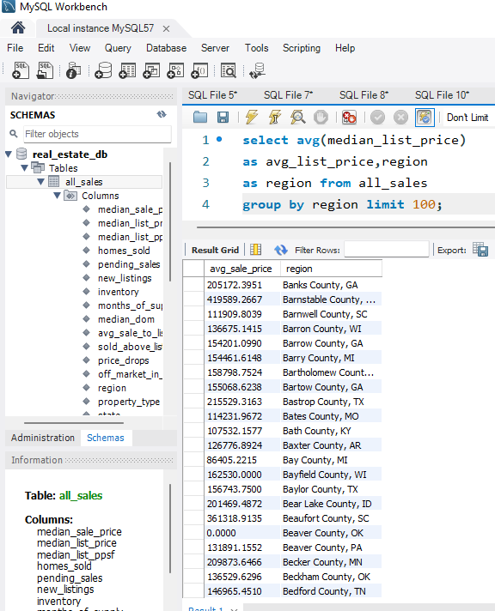
Case study 8

Slide 24
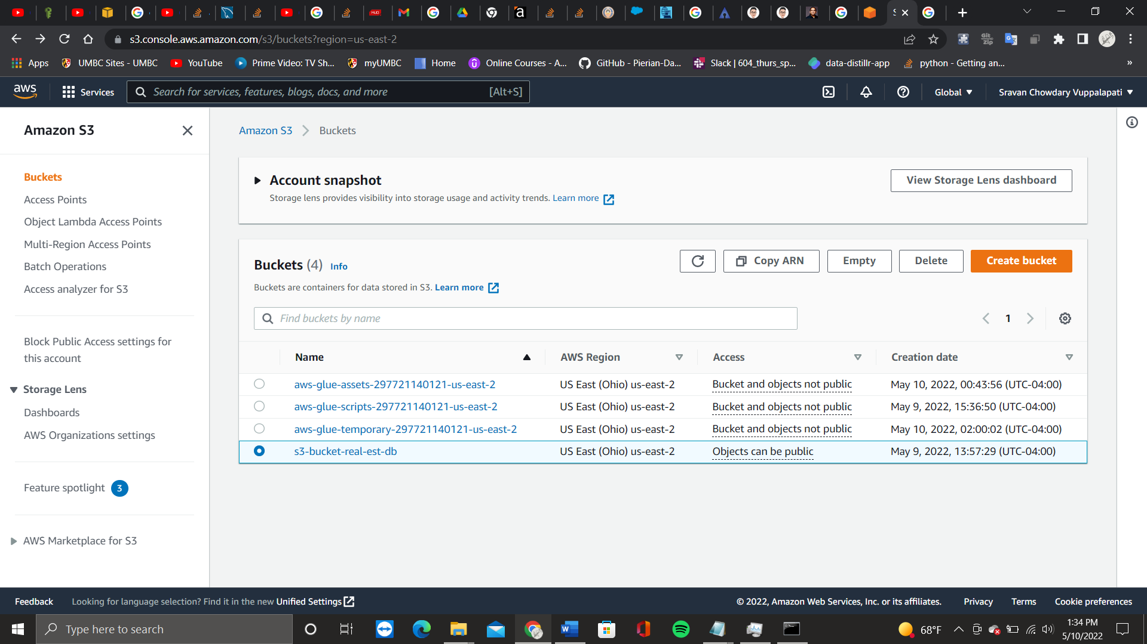
``````````````````````````````````1

Slide 25
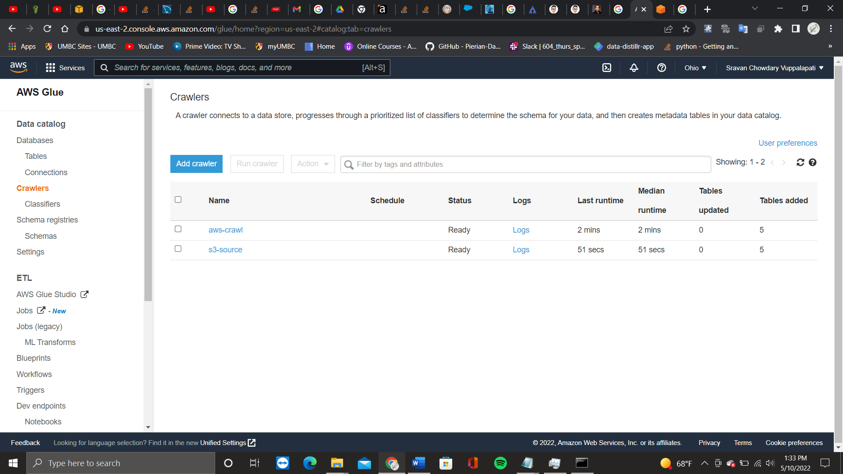

Slide 26
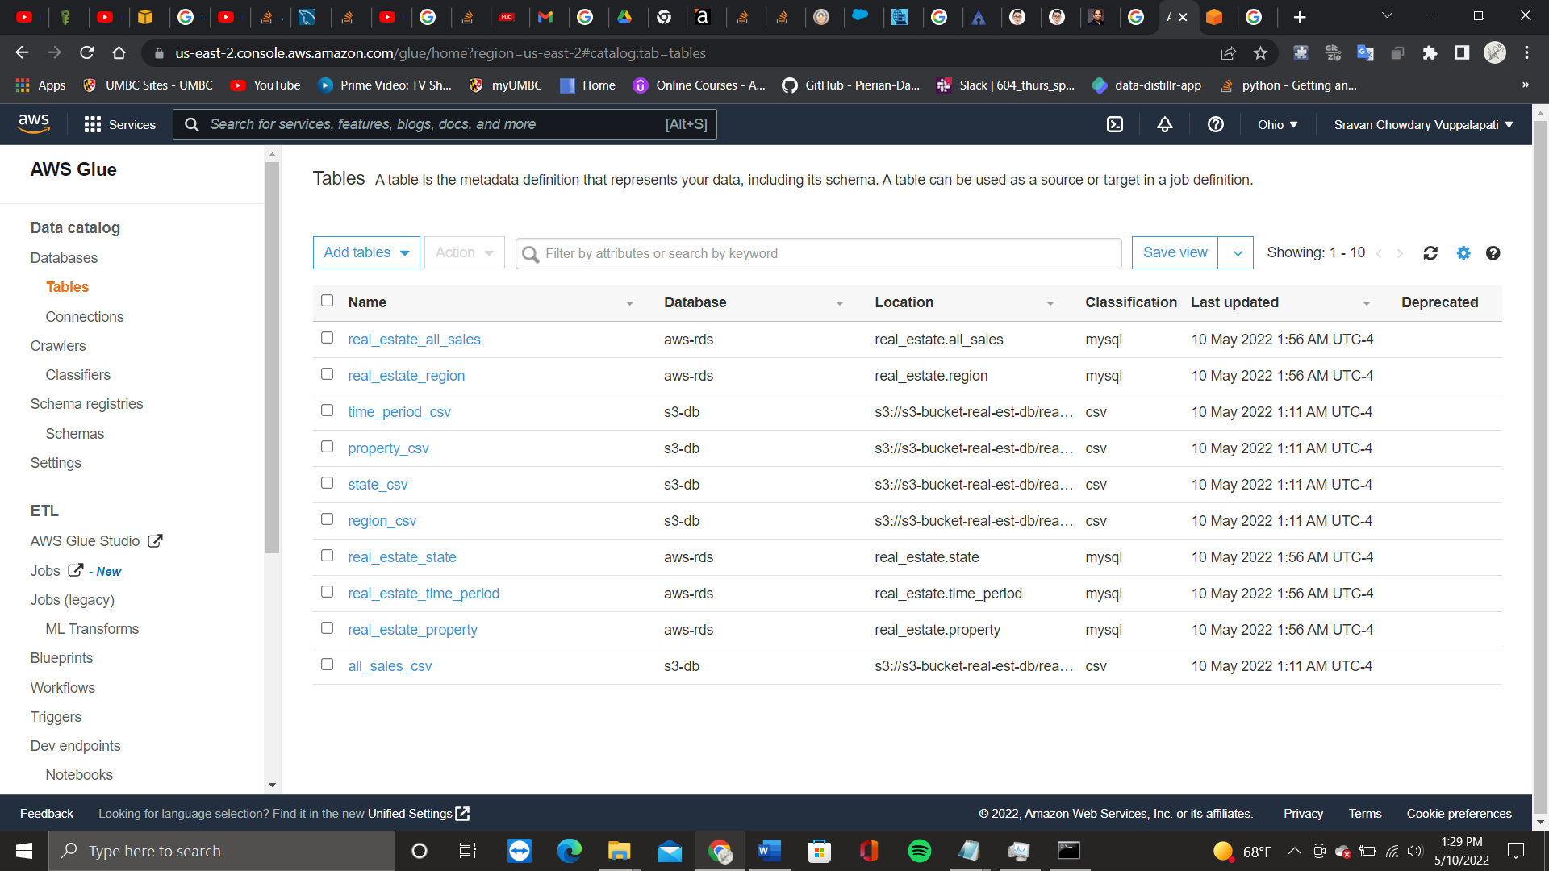

Slide 27
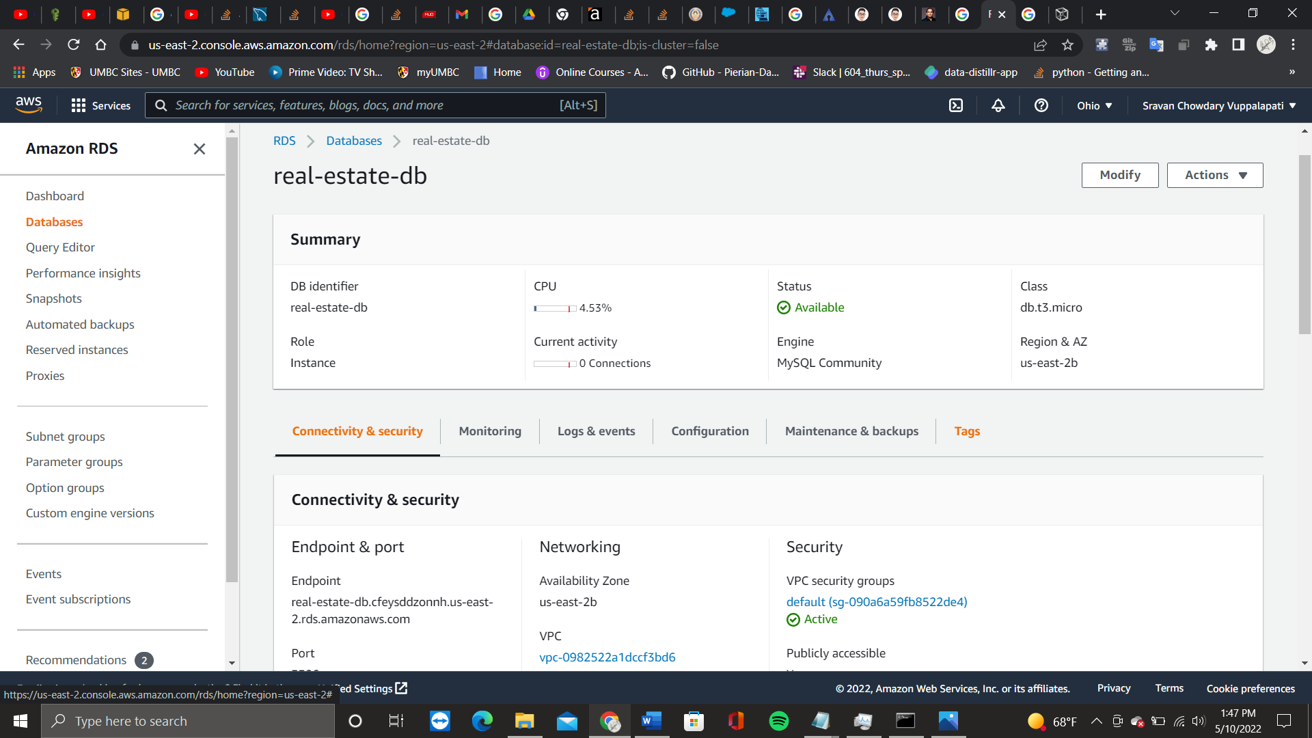

Slide 28
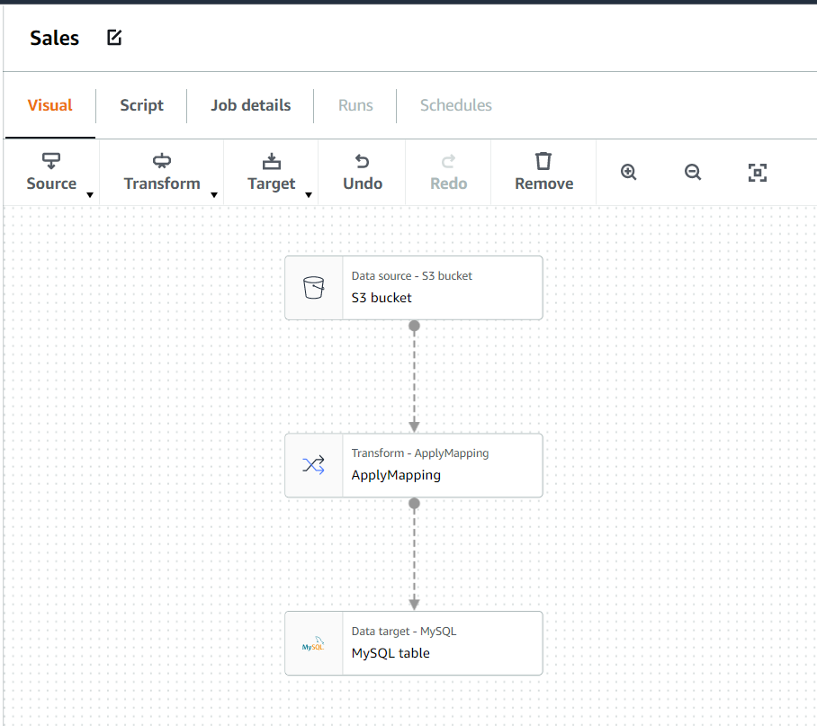

Slide 29
AWS PRICING CALCULATOR | Per month
AWS S3 | 1150 $
RDS | 404.02 $
Amazon Glue | 1.41 $

Slide 30
It is important to engage in data analysis to understand how Housing Market and their prices has been changing to predict the Future Market
Conclusion

Slide 31
THANK YOU...

